Slide 1



CDL Quantum Hackathon 2021
Solving Maximun Entropy Method as QUBO problem
Inés Corte, Federico Holik, Marcelo Losada, Lorena Rebón, Diego Tielas

Slide 2
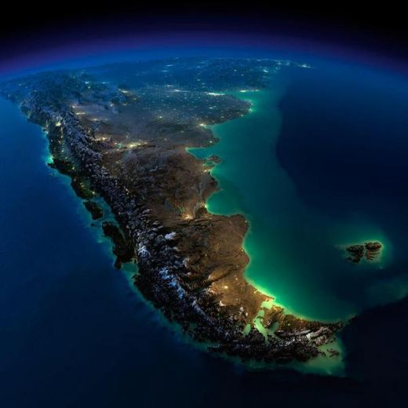







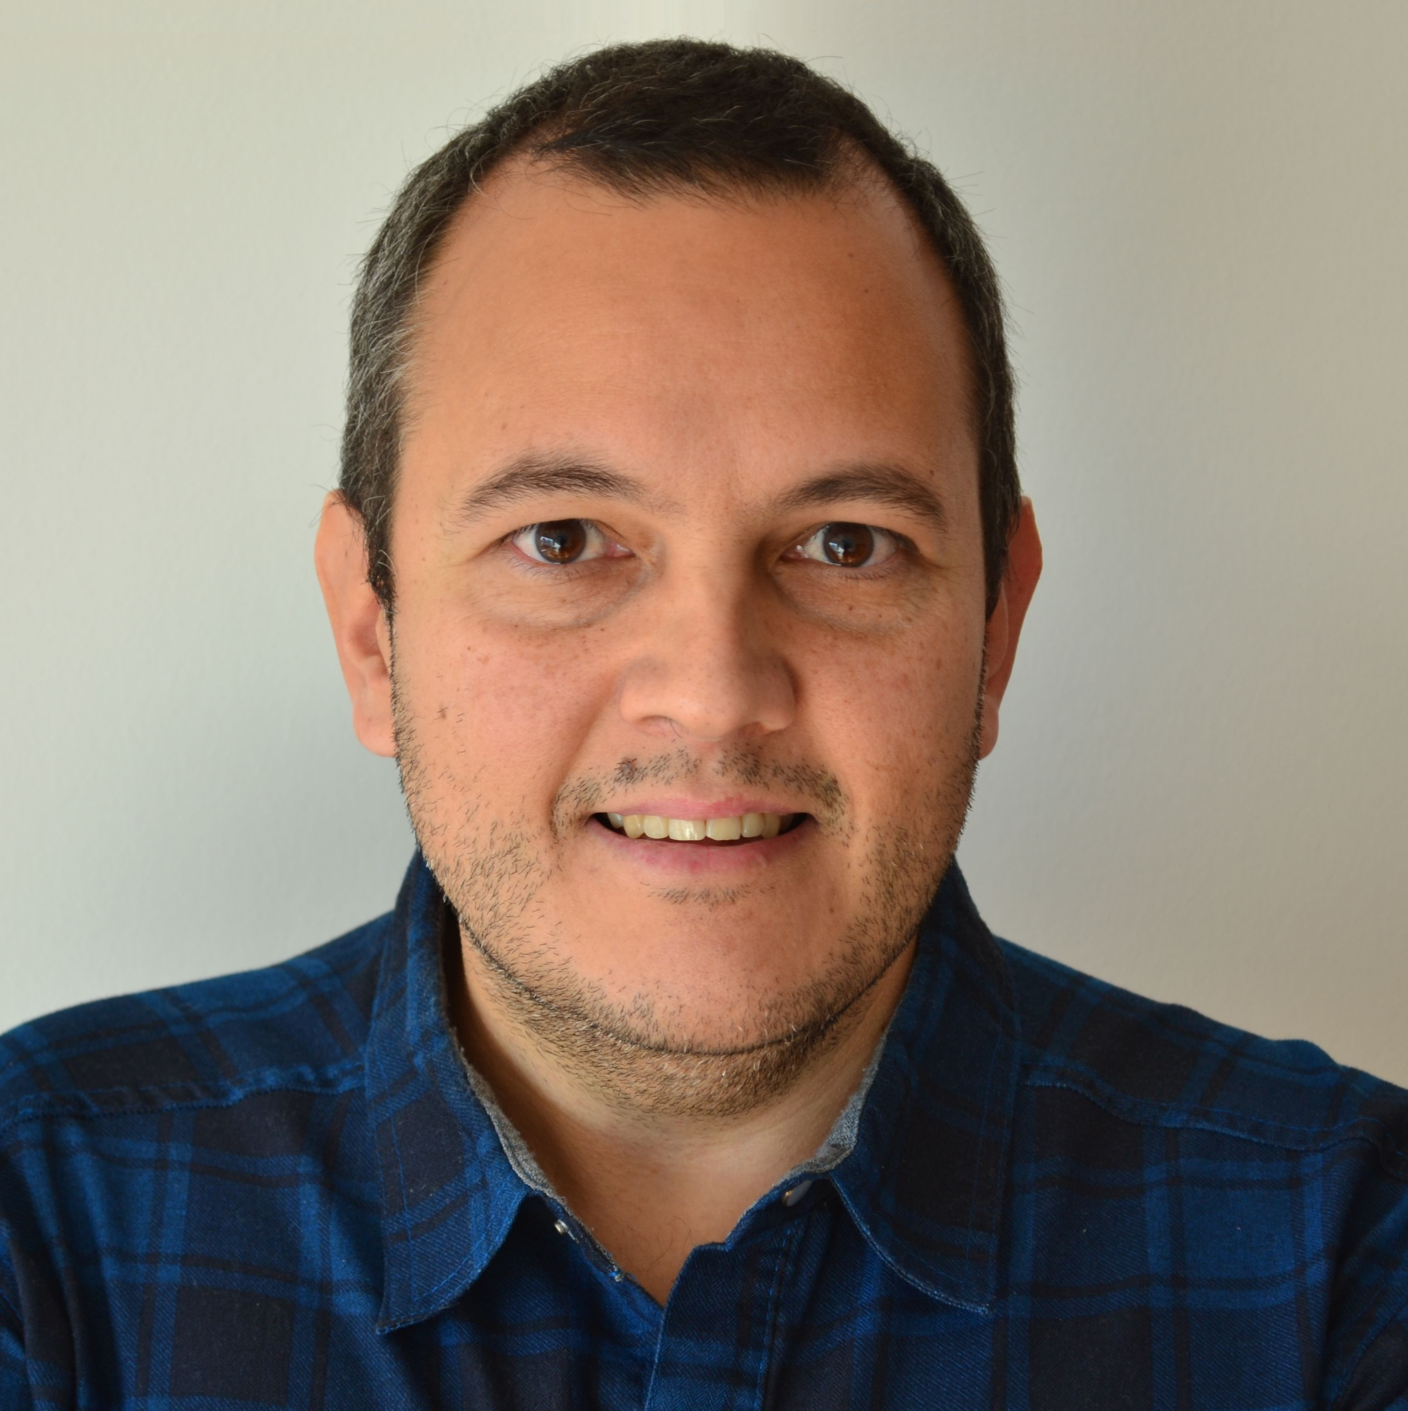
Ines Corte
Marcelo Losada
Lorena Rebón
Federico Holik
Diego Tielas
Quantum Vision Team:

Slide 3
Outlook:
a) Maximum Entropy Principle
b) Potential Applications
c) Solving MaxEnt as a QUBO problem
d) Proof of concept
f) Business proposal

Slide 4
Maximum Entropy Principle

Slide 5

General idea of the Principle
Suppose that the available information is not sufficient to determine the distribution function of the system

Slide 6
General idea of the Principle
Suppose that the available information is not sufficient to determine the distribution function of the system
That is, there is more than one distribution compatible with the available information.

Slide 7
General idea of the Principle
Suppose that the available information is not sufficient to determine the distribution function of the system
That is, there is more than one distribution compatible with the available information
Which one should we choose?

Slide 8
General idea of the Principle
Suppose that the available information is not sufficient to determine the distribution function of the system
That is, there is more than one distribution compatible with the available information
Which one should we choose?
Jaynes: We choose the one with maximum entropy!
E. T. Jaynes Phys. Rev. 106, 620 (1957).
E. T. Jaynes Phys. Rev. 108, 171 (1957).

Slide 9
Potential Applications

Slide 10

Continuous-scale gold prospectivity map of the Tangbale-Hatu belt generated from MaxEnt model
Liu, Yue et. al. Ore Geology Reviews, 100, 133, 2018.

Slide 11
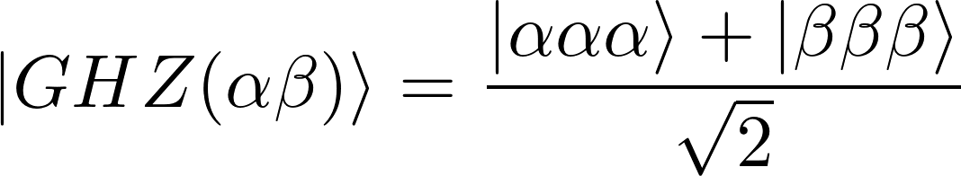
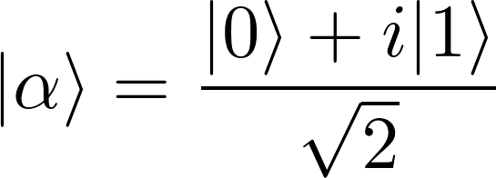
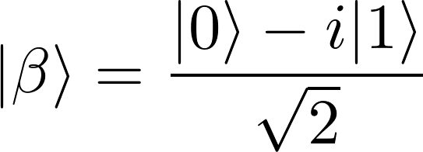
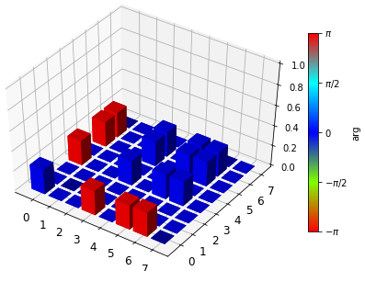
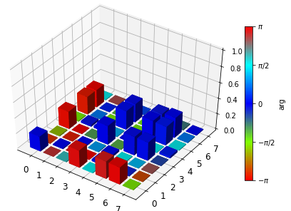
Quantum Systems:
with
Quantum Vision Team

Slide 12
Solving MaxEnt as a QUBO problem

Slide 13
MaxEnt formulation:

Slide 14
MaxEnt formulation:

Slide 15
MaxEnt formulation:
Change the entropy for a linearized version

Slide 16
MaxEnt formulation:
Change the entropy for a linearized version
Binarize the probabilities

Slide 17
MaxEnt formulation:
Change the entropy for a linearized version
Binarize the probabilities
Build the QUBO problem

Slide 18
MaxEnt formulation:
Change the entropy for a linearized version
Binarize the probabilities
Build the QUBO problem
Solve with D-Wave system

Slide 19
Proof of concept

Slide 20
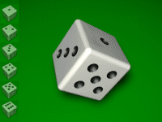
Proof of concept

Slide 21
Example 1: with fair mean value

Slide 22
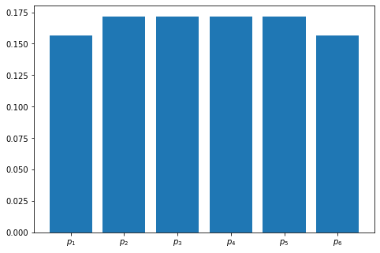
Example 1: with fair mean value

Slide 23
Example 2: Loaded dice

Slide 24
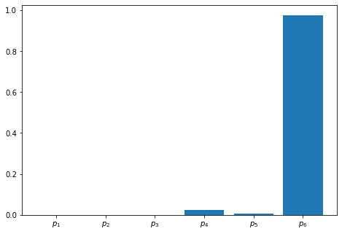
Example 2: Loaded dice

Slide 25
Example 3: Dice with one face with fixed probability

Slide 26
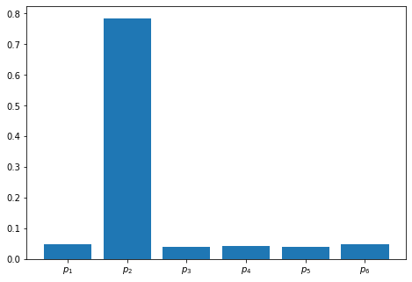
Example 3: Dice with one face with fixed probability

Slide 27
Example 4: Dice with two faces summing a fixed probability

Slide 28
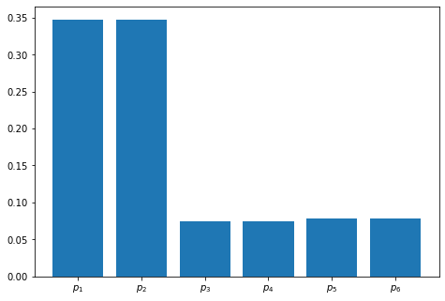
Example 4: Dice with two faces summing a fixed probability

Slide 29
Business Proposal

Slide 30
Platform:

Slide 31
Platform:
                Probabilistic models ready for use.

Slide 32
Platform:
                Probabilistic models ready for use.
                Easily implementable set of constrains

Slide 33
Platform:
                Probabilistic models ready for use.
                Easily implementable set of constrains
                Simple protocol for uploading data

Slide 34
Platform:
                Probabilistic models ready for use.
                Easily implementable set of constrains
                Simple protocol for uploading data
                Simple-setting solvers.

Slide 35
Thank for your atention!

